Slide 1
Pediatric* Trauma MTP
*Children >50kgs follow ADULT MTP
Controlled Resuscitation
Use blood in ED refrigerator & place order for uncrossmatched blood
Hemogram, Coags, Fgn if possible
Volume Guide from refrigerator
(use ml, wt based) <10 kg – 1 unit PRBCs
10-20 kg – 2 units PRBCs
20-50 kg – 3 units PRBCs
>50 kg use ADULT MTP guide
Activate PEDS MTP
Contact Blood Bank (35401 or 35403) to “activate pediatric MTP”
Give proper age and biologic sex of patient (Peds MTP ≤ 15 yrs)
Surgeon must designate and place MTP order
Send runner for cooler
NO
Bleeding Controlled
STOP
Transfusion
Resusc
YES
Send blood bank specimen directly to Blood Bank (Tube #103 or #630)
Cooler #1: 4 RBC/ 4FFP/ 1 6pk Pheresis plt
Bleeding Controlled
NO
YES
Cooler #2: 4 RBC/ 4FFP/ 1 6pk Pheresis plt
Notify Blood Bank: Stop MTP
NO
Bleeding Controlled
†Consider Cryo with Cooler # 2 or 3
<10kg – 1 unit (ml)
10-20 kg – 2 units (ml)
20-50kg – 3 units (ml)
†Call if needed
Cooler #3: 4 RBC/ 4FFP
Provider Info for Controlled Resuscitation Pack
< 10kg – 1 unit PRBCs/1FFP
10-20kg – 2 units PRBCs/2FFP/ (1/3) PLT
20-50kg – 3 units PRBCs/3FFP/(1/2) PLT
Volumes weight based ml 1:1:1 (pheresis PLT = 6pk)
NO
Bleeding Controlled
Cooler #4: 4 RBC/ 4FFP/ 1 6pk Pheresis plt

Slide 2
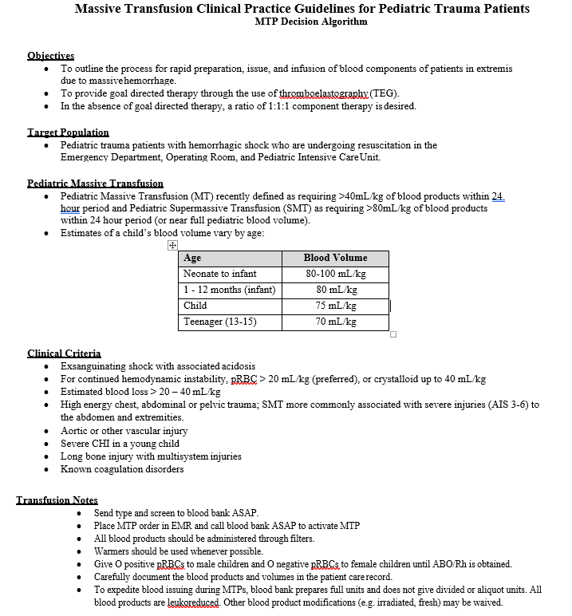

MTP page 2
(description)
The information contained herein has been compiled as part of UK HealthCare’s Patient Safety Evaluation Systems, is deemed to be Patient Safety Work Product, and is privileged and confidential.
Kentucky Children's Hospital

